Slide 1

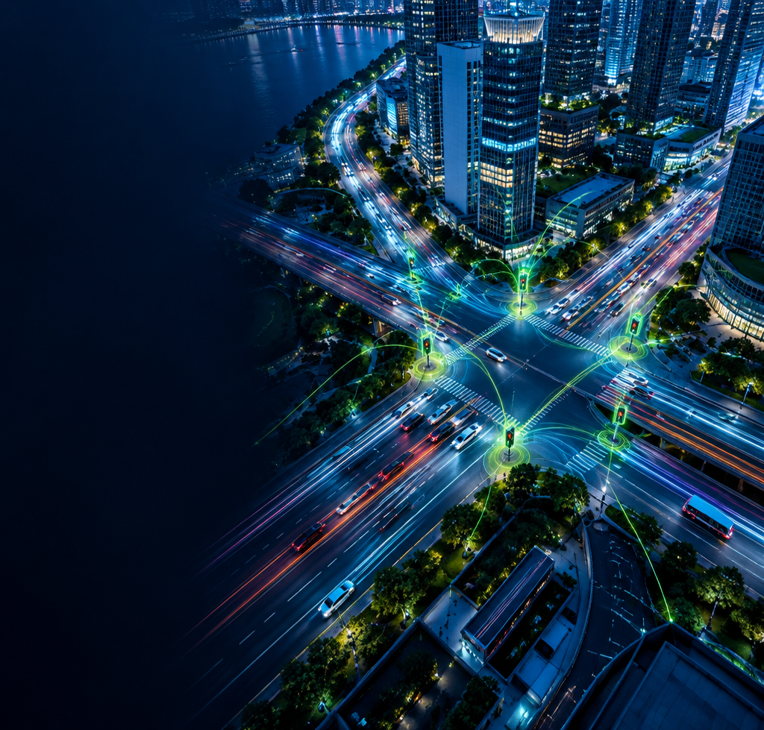

SMART TRAFFIC
MANAGEMENT SYSTEM
DESIGN THINKING FOR INNOVATION AND ENTREPRENEURSHIP (DTIE)
TEAM MEMBERS: Samhita 2620090087 ·
Neeharika - 2620030332
Abhinaya - 2620030615 ·
Sudiksha - 2620030036
Sushma - 2620030374 ·
Ridhi - 2620030032

Slide 2

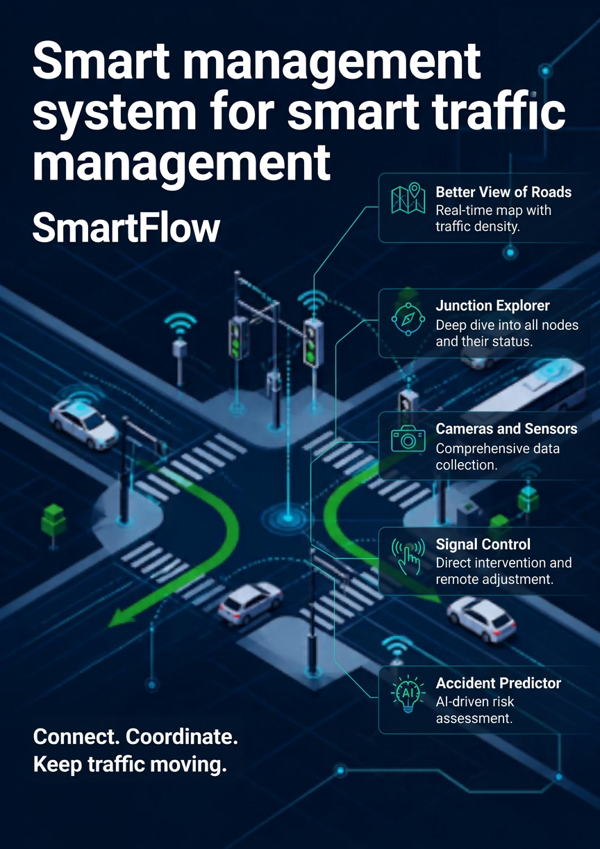

Slide 3

VISION
“To enable efficient, real-time traffic management through innovative digital solutions.”
To create a smarter, more efficient, and sustainable urban transportation system through innovative digital solutions. Smartflow envisions a future where traffic conditions can be monitored in real time, congestion can be identified quickly, and traffic signals can be managed more effectively. By improving traffic visibility and supporting timely decisions, we aim to make daily commuting smoother, reduce unnecessary delays, and contribute to better urban mobility.

Slide 4

Mission
Develop Smartflow, a web platform providing live traffic tracking and smart signal control to reduce congestion and improve urban mobility.
Our mission is to develop Smartflow, a centralized web platform that integrates live traffic monitoring with smart traffic signal control. The platform aims to help traffic authorities and operators view traffic conditions across selected regions, identify congestion, and manage signals through a unified interface. By reducing dependence on fragmented monitoring systems and supporting faster, more informed decisions, Smartflow seeks to improve traffic coordination, optimize road usage, and enhance the overall commuting experience. Our focus is to provide an accessible, user-friendly, and scalable solution that can support the evolving traffic management needs of urban areas.

Slide 5


PROBLEM STATEMENT:
Urban mobility is constrained by systems that cannot adapt at city speed.
Traffic systems react
too slowly.
01
02
03
CONGESTION
STATIC CONTROL
SYSTEM NEED
Delays, pollution, and economic loss compound across the city.
Traditional management lacks real-time adaptability and centralized control.
Signals must be monitored and controlled dynamically as one integrated network.

Slide 6
RESEARCH/MARKET AND INDUSTRY STUDY:
Three forces shape the market
URBAN PRESSURE
SMART-CITY DEMAND
FRAGMENTED SYSTEMS
Rapid urbanization increases traffic volume in metropolitan areas.
Cities increasingly seek IoT and data analytics solutions.
Existing traffic control is often split across manual and isolated tools.

Slide 7

TARGET USER/ CUSTOMER:
Decision-makers, operators, and the moving public share one operational picture.
One platform.
Four perspectives.
01 Municipal traffic authorities & city planners
02 Traffic control operators & administrators
03 Commuters benefiting from improved flow
04 Public transport agencies optimizing routes

Slide 8


COMPETITORS/BENCHMARKS:
From visibility to action
ADAPTIVE SIGNAL CONTROL
Strong local optimization
Often hardware-bound and limited in regional visibility
REGIONAL TRAFFIC WEBSITES
Broad live monitoring
Limited operator control and fragmented workflows
SMARTFLOW
Live tracking + signal control
Unified regional view with centralized operator action

Slide 9

Risks
The market gap
Data accuracy & latency
System integration challenges
User adoption hurdles
No unified platform combines live regional traffic monitoring with signal control. Operators need a scalable, user-friendly interface.

Slide 10
CONCEPT/PROTYPE/SOLUTION:
See the city.
Change the flow.
A unified website platform for live traffic visibility and operator control.
1 SELECT
Region selection
2 MONITOR
Live traffic status
3 OPTIMIZE
Real-time signal control
4 MANAGE
Central admin view
Intuitive dashboards make congestion visible — and action immediate.

Slide 11
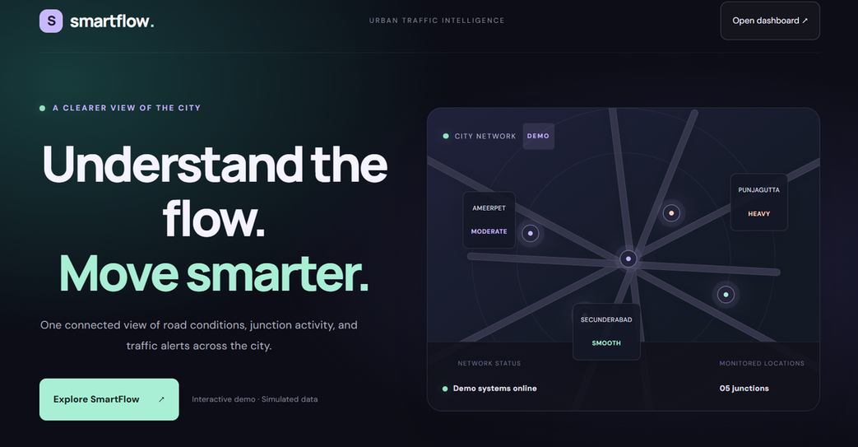
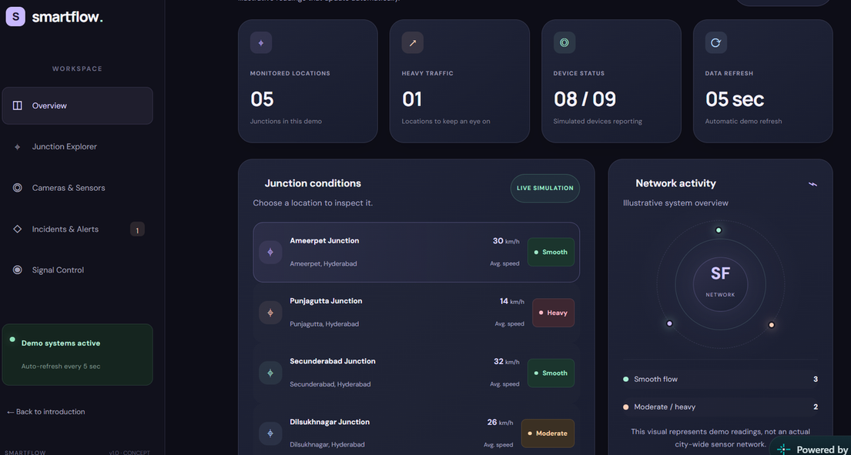
STORYBOARD/ARCHITECTURE:
Control room,
without the walls.
Regional selection → live traffic map → signal action → admin oversight
WEBSITE LINK: smartflowtrafficmanagement.netlify.app

Slide 12


LEAN CANVAS MODEL:
PROBLEM
SOLUTION
KEY METRICS
UNIQUE VALUE
Congestion; static, fragmented control
Live tracking and smart signal control
Coverage, response time, congestion trend
One view from regional insight to operator action
CUSTOMERS
CHANNELS
COST STRUCTURE
REVENUE STREAMS
Authorities, planners, operators, transit agencies
Municipal pilots, partnerships, public procurement
Platform, infrastructure, integration, support
Licensing, implementation, service contracts

Slide 13


CAPITAL(FINANCIAL):
From software foundation to city-scale operations.
Capital follows
the system.
BUILD
CONNECT
SUSTAIN
FUND
Web platform and backend infrastructure
Hardware for traffic signal integration
Maintenance, support, and operator enablement
Institutional budgets, grants, and partnerships

Slide 14
ROADMAP/TIMELINE:
A year from idea to rollout
Q1
Q2
Q3
Q4
Requirements & design
Prototype & initial testing
Pilot in selected regions
Full rollout & operator training

Slide 15


THANK YOU!
This presentation summarizes the Smartflow project intended for live traffic monitoring and signal control, aiming to enhance urban traffic management through digital innovation.
SMARTFLOW / LIVE. DECIDE. MOVE.

